Slide 1
Logical Agents
Fundamentals of Artificial Intelligence
Slides are mostly adapted from AIMA and MIT Open Courseware

Slide 2
Outline
Knowledge-based agents
Wumpus world
Logic in general - models and entailment
Propositional (Boolean) logic
Equivalence, validity, satisfiability
Inference rules and theorem proving
  Resolution
  forward chaining
  backward chaining

Slide 3
Horn Clauses
Horn Form (restricted)
  KB = conjunction of Horn clauses
  Horn clause =
  proposition symbol (conjunction of symbols) ⇒ symbol
  P1 ∧ P2 ∧ ….. ∧ Pn ⇒ Q
  where Pi and Q are nonnegated atoms
  E.g., C ∧ (B ⇒ A) ∧ (C ∧ D ⇒ B)
When Q is False we get a sentence that is equivalent to
¬ P1 ∨ ¬ P2 ∨ ….. ∨ ¬ Pn
When n=1 and p1 is True we get True ⇒ Q
which is equivalent to Q
Notes:
There is a useful class of sentences which are called as Horn clauses
A Horn clause has the form
P1 and P2 and …. Pn -> Q
There are two important special cases
When Q is False we get a sentence that is equivalent to
νοτ P1 or not P2 … or not Pn
When n=1 and p1 is True we get True -> Q
which is equivalent to Q

Slide 4
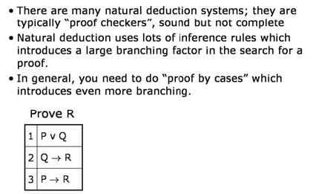
Proof systems

Slide 5
Forward and backward chaining
Modus Ponens (for Horn Form): complete for Horn KBs
α₁, … ,α_{n}, α₁ ∧ … ∧ α_{n} ⇒ β
β
Can be used with forward chaining or backward chaining.
These algorithms are very natural and run in linear time
Notes:
An inference rule such as Modus Ponens is called local, because its premise need only be to compared with a small portion of the KB (only two rules)
Were it not for monotonicity, we could not have any local inference rules
Because the rest of the KB might affect the soundness of the inference.
On the other hand, Although not every KB can be written as a collection of Horn clauses, for ones that can, we can use Modus Ponens.
For Horn clauses the inference procedure is polynomial time.
We will see two methods: forward chaining and backward chaining

Slide 6
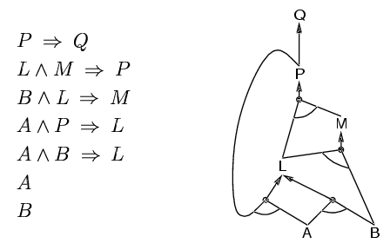
Forward chaining
Idea: fire any rule whose premises are satisfied in the KB,
  add its conclusion to the KB, until query is found
Notes:
The idea of Forward chaining is to fire any rule whose premises are satisfied in KB.
It world by adding new conclusions to KB until the query (conclusion) is found.

Slide 7
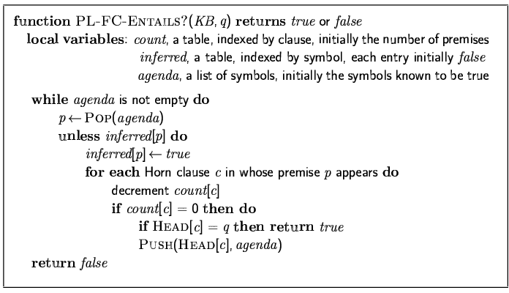
Forward chaining algorithm
Forward chaining is sound and complete for Horn KB

Slide 8
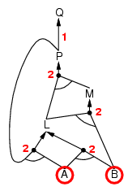
Forward chaining example
Notes:
We start from literals A and B

Slide 9
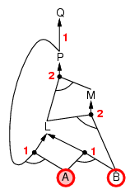
Forward chaining example

Slide 10
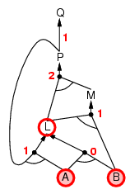
Forward chaining example
Notes:
Since there is sentence
A and B -> L
We can conclude about L, and add it to our list

Slide 11
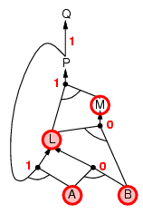
Forward chaining example
Notes:
Now, we have a rule
B and L -> M
So we add M

Slide 12
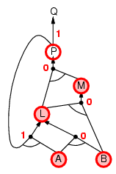
Forward chaining example
Notes:
From
L and M -> P
We have P

Slide 13
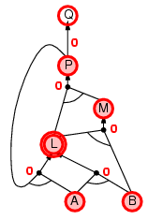
Forward chaining example
Notes:
There is another rule
A nd P -> L

Slide 14
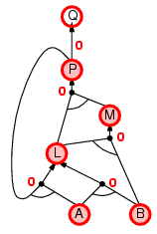
Forward chaining example
Notes:
we have L again

Slide 15

Forward chaining example
Notes:
From P-> Q
Wre have Q

Slide 16
Proof of completeness
FC derives every atomic sentence that is entailed by KB
  FC reaches a fixed point where no new atomic sentences are derived
  Consider the final state as a model m, assigning true/false to symbols
  Every clause in the original KB is true in m
    a₁ ∧ … ∧ a_{k ⇒} b
  Hence m is a model of KB
  If KB╞ q, q is true in every model of KB, including m

Slide 17
Backward chaining
Idea: work backwards from the query q:
  to prove q by BC,
    check if q is known already, or
    prove by BC all premises of some rule concluding q
Avoid loops: check if new subgoal is already on the goal stack
Avoid repeated work: check if new subgoal
  has already been proved true, or
  has already failed
Notes:
The idea of backward chaining is to start from the query
To prove Q
check if q is known already, or
prove by BC all premises of some rule concluding q

Slide 18
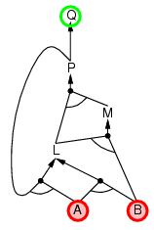
Backward chaining example

Slide 19
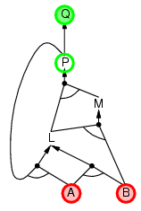
Backward chaining example

Slide 20
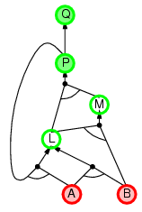
Backward chaining example

Slide 21
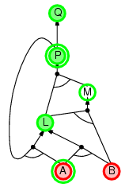
Backward chaining example

Slide 22
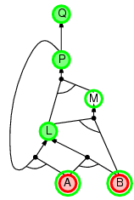
Backward chaining example

Slide 23
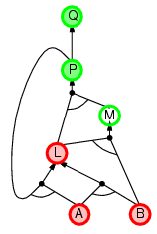
Backward chaining example

Slide 24
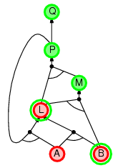
Backward chaining example

Slide 25
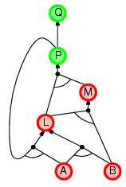
Backward chaining example

Slide 26
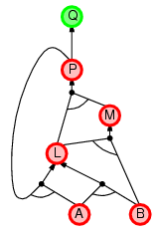
Backward chaining example

Slide 27
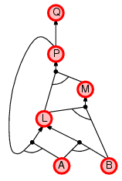
Backward chaining example

Slide 28
Forward vs. backward chaining
FC is data-driven, automatic, unconscious processing,
  e.g., object recognition, routine decisions
May do lots of work that is irrelevant to the goal
BC is goal-driven, appropriate for problem-solving,
  e.g., Where are my keys? How do I get into a PhD program?
Complexity of BC can be much less than linear in size of KB

Slide 29
Summary
Logical agents apply inference to a knowledge base to derive new information and make decisions
Basic concepts of logic:
  syntax: formal structure of sentences
  semantics: truth of sentences wrt models
  entailment: necessary truth of one sentence given another
  inference: deriving sentences from other sentences
  soundness: derivations produce only entailed sentences
  completeness: derivations can produce all entailed sentences
Wumpus world requires the ability to represent partial and negated information, reason by cases, etc.
Resolution is complete for propositional logic
Forward, backward chaining are linear-time, complete for Horn clauses
Propositional logic lacks expressive power

Slide 30
Proof methods
Application of inference rules
  Legitimate (sound) generation of new sentences from old
  Proof = a sequence of inference rule applications
  Can use inference rules as operators in a standard search algorithm
  Typically require transformation of sentences into a normal form
Model checking
  truth table enumeration (always exponential in n)
  improved backtracking, e.g., Davis--Putnam-Logemann-Loveland (DPLL)
  heuristic search in model space (sound but incomplete)
  e.g., min-conflicts-like hill-climbing algorithms

Slide 31
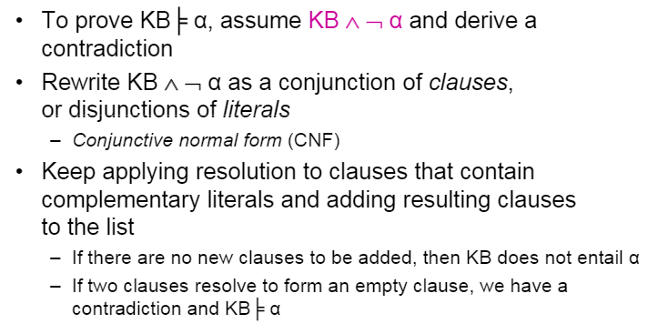

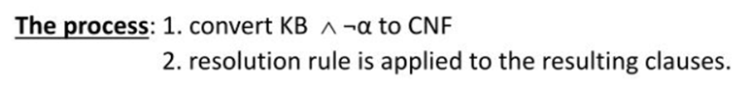
Resolution as a complete inference

